Slide 1

A practical implementation of Pixel based tracking in Power BI
Alex Dupler
Program Manager - Microsoft Advertising

Slide 2
Contents
Overview
Flow Setup
Measure Setup
Visual Setup
Modify for Live Connect Users
Security Considerations
SQL Stuff (if there is time)
Links

Slide 3








Overview
Measure Invokes HTTP Trigger
Replies with Image
Parses URL for Parameters
Inserts Rows into SQL
Stores Data
Power BI
Power Automate
SQL

Slide 4
Diagram
Measure invokes HTTP Trigger
Inserts Rows
Dax assembles tracking data
Responds with Image
Parse URL’s {DATA} package
Stores Data

Slide 5
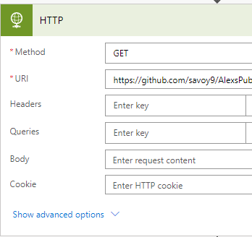
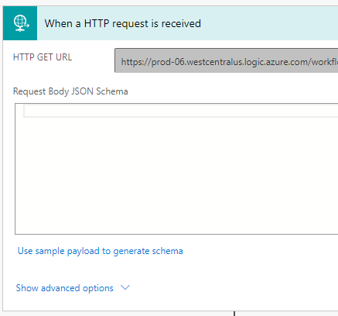
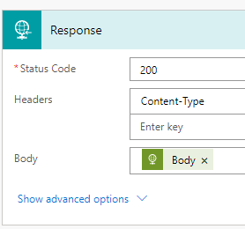
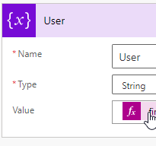
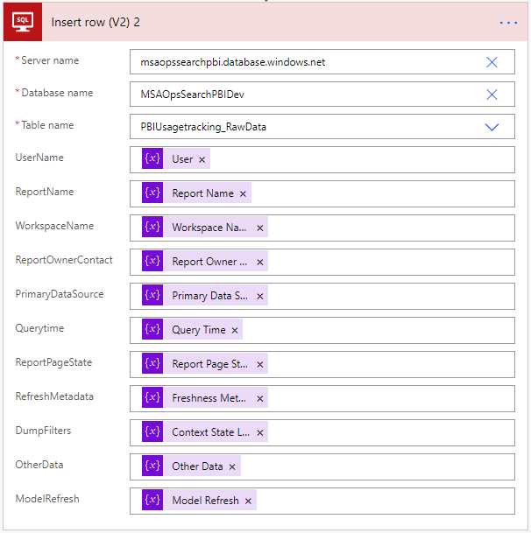
Flow Setup
Start with an HTTP Trigger
Use the HTTP actions’ GET Method to fetch the image
Note that this is a Premium action that requires a flow subscription
Respond to Power BI with the image
Parse the URL’s {data} package into variables
Insert the parsed data into SQL

Slide 6
Measure Setup
Pseudo Code
Power BI Usage Tracking Measure = //**SETUP** Fill Out these Variables with your information Var Param1 = "Text" Var Param2 = Calculate( ) Var Param3 = SelectedValue( ) Var Param4 = UserPrincipleName() Var FlowRequestBaseURL =
"https://....logic.azure.com/workflows/...UserData/{Data}..." // This Assembles the Data Package to send to flow Var AssembledDataPacakge = Param1 & ";" & Param2 & ";" & Param3 & ";" & Param4 // Clean the package for spaces VAR CleanedDataPackage = SUBSTITUTE ( AssembledDataPacakge," ", "%20" ) // This is the final URL to send to flow VAR AssembledURL = SUBSTITUTE(FlowRequestBaseURL, "{Data}", CleanedDataPackage) Return AssembledURL
Data my team collects in the measure
Automatic Variables
Report Viewer AAD Email
Report Interaction Time
Required Fixed Parameters
Report Name
Workspace Name
Report Owner Name
Primary Data Source
Optional Parameters
Report State (Report Page & Bookmarks)
Data Refresh Metadata
Filter State
Other

Slide 7
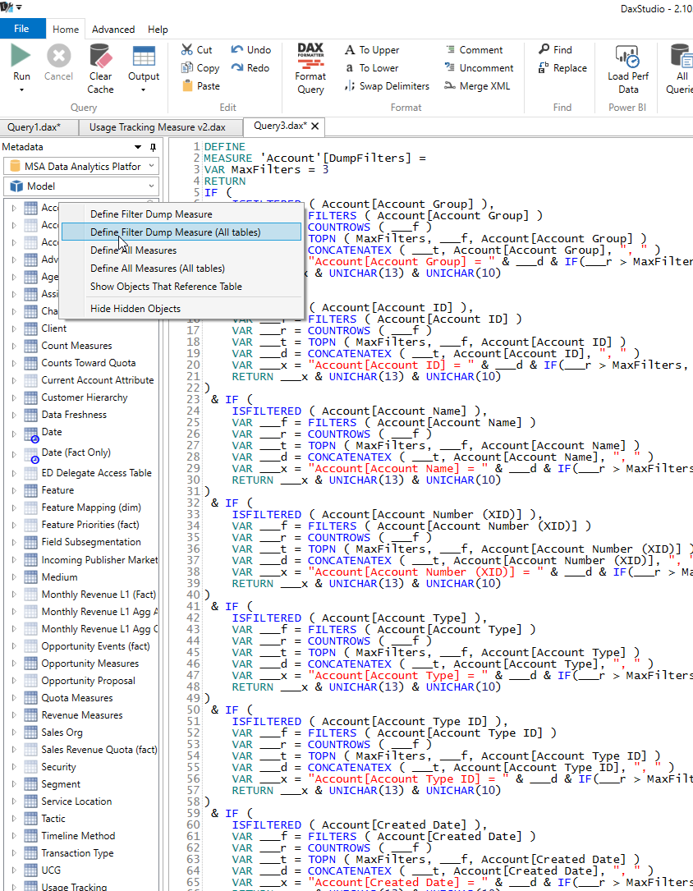
Measure Setup Part 2
Dump Filters in Dax Studio
☺ Enables tracking the entire filter state of the model.
☺ Programmatically generated
☹ Measure must be updated every time you change the model

Slide 8
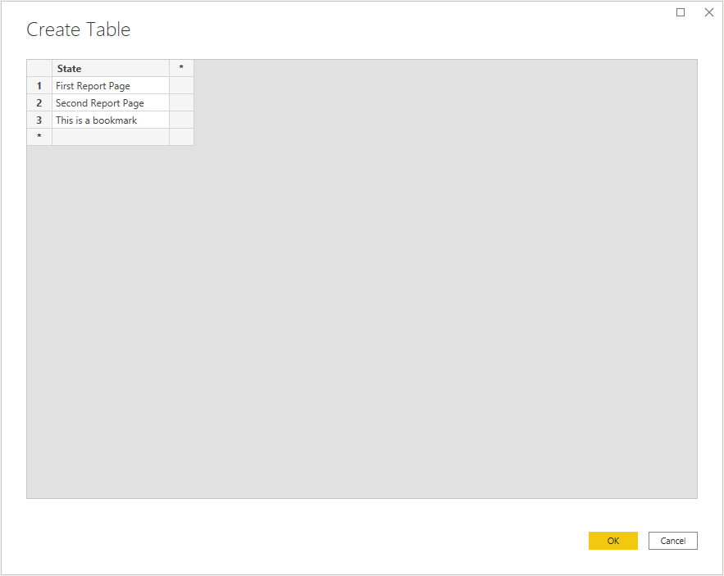
Measure Setup Part 3
Report Page Tracking
Add a table to your data model that contains a list of the report pages and/or bookmarks you want to track.

Slide 9
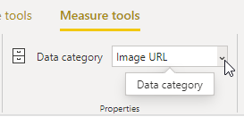
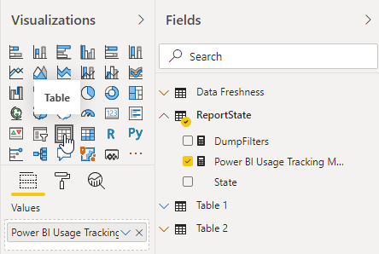
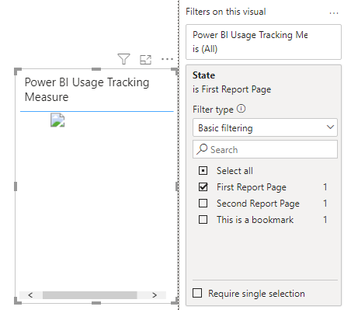
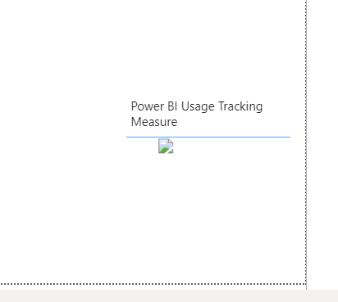
Power BI Visual Setup
Label Measure as Image URL
Add Measure to a Table Visual
Filter visual to Report State
Hide visual in corner

Slide 10
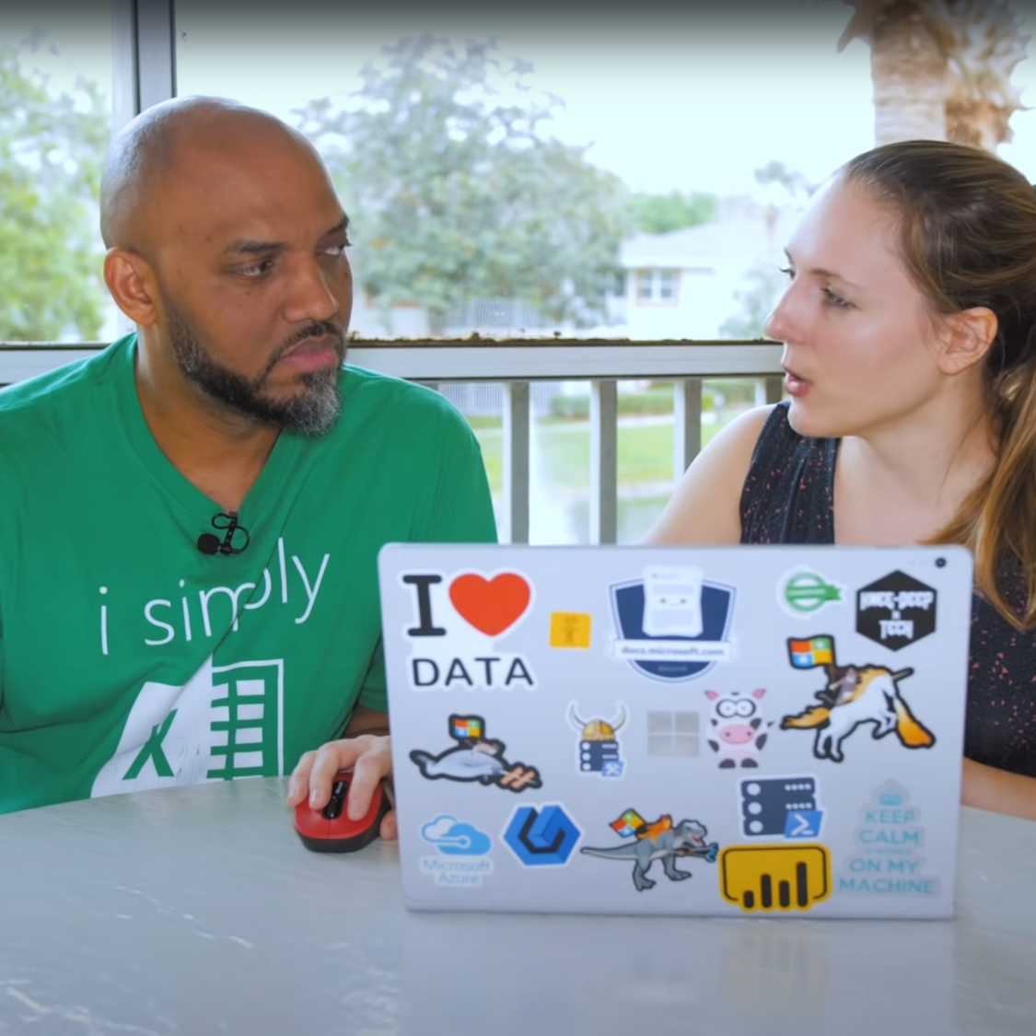
Demo
Head over to the laptop

Slide 11
Organizational Implementation
Deploy single Flow and corresponding SQL Table
Provide DAX code as a template for other PBI Authors to implement in Import mode models.
Implement measure as component of any major cubes or data models that you expect other PBI Authors to produce live connect reporting against.
Provide usage data back to your authors
Thoroughly Document and Comment your code

Slide 12
Modify for Live Connect Users
Give users a way to enter report specific parameters into a table in your cube
Stage the data to protect your cube from refresh issues
SharePoint List
Shared Excel File
MS Forms
PBI Dataflows Flow to SQL

Slide 13

Things to look out for
The tracker will fire every time a visual with the tracking measure is filtered.
This includes
Report Loads,
Changing report pages
Some Bookmark changes
Page level filters and slicers
It does not include
Visual Level slicers
Bookmarks that don’t effect filters
Slicers and cross filtering with edit interactions to not effect the visual

Slide 14

Security Considerations
Image URLs in general are a vector that malicious report authors can use to egress data.
This implementation captures and stores PII (AAD User Names).
While Employee data is not subject to the same restrictions as other PII under GDPR your employer may have policies for handling employee data.
If you are using Power BI embedded or B2B connect, you may capture non-employee PII this way. You’ll need to make sure you follow relevant policies and regulations.
If you are using Publish to Web this mechanism will still work but UserPrincipleName probably won’t return anything meaningful (you should test this). This may be the only viable way to get report page tracking in publish to web.

Slide 15

Links
Gil Raviv’s Blog Post
Alex’s Blog Post (coming soon)
Dax Measure Template
Flow Template
SQL Create Table Template
Dax Studio

Slide 16
advertising.microsoft.com

